Slide 1
St. Louis Central Corridor West Building Permits
Quarter 3 Report: 2020

Slide 2
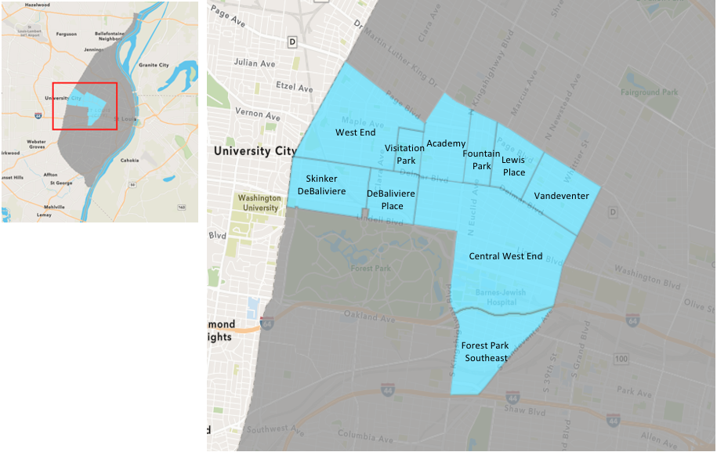
St. Louis Neighborhood Spatial Reference

Slide 3
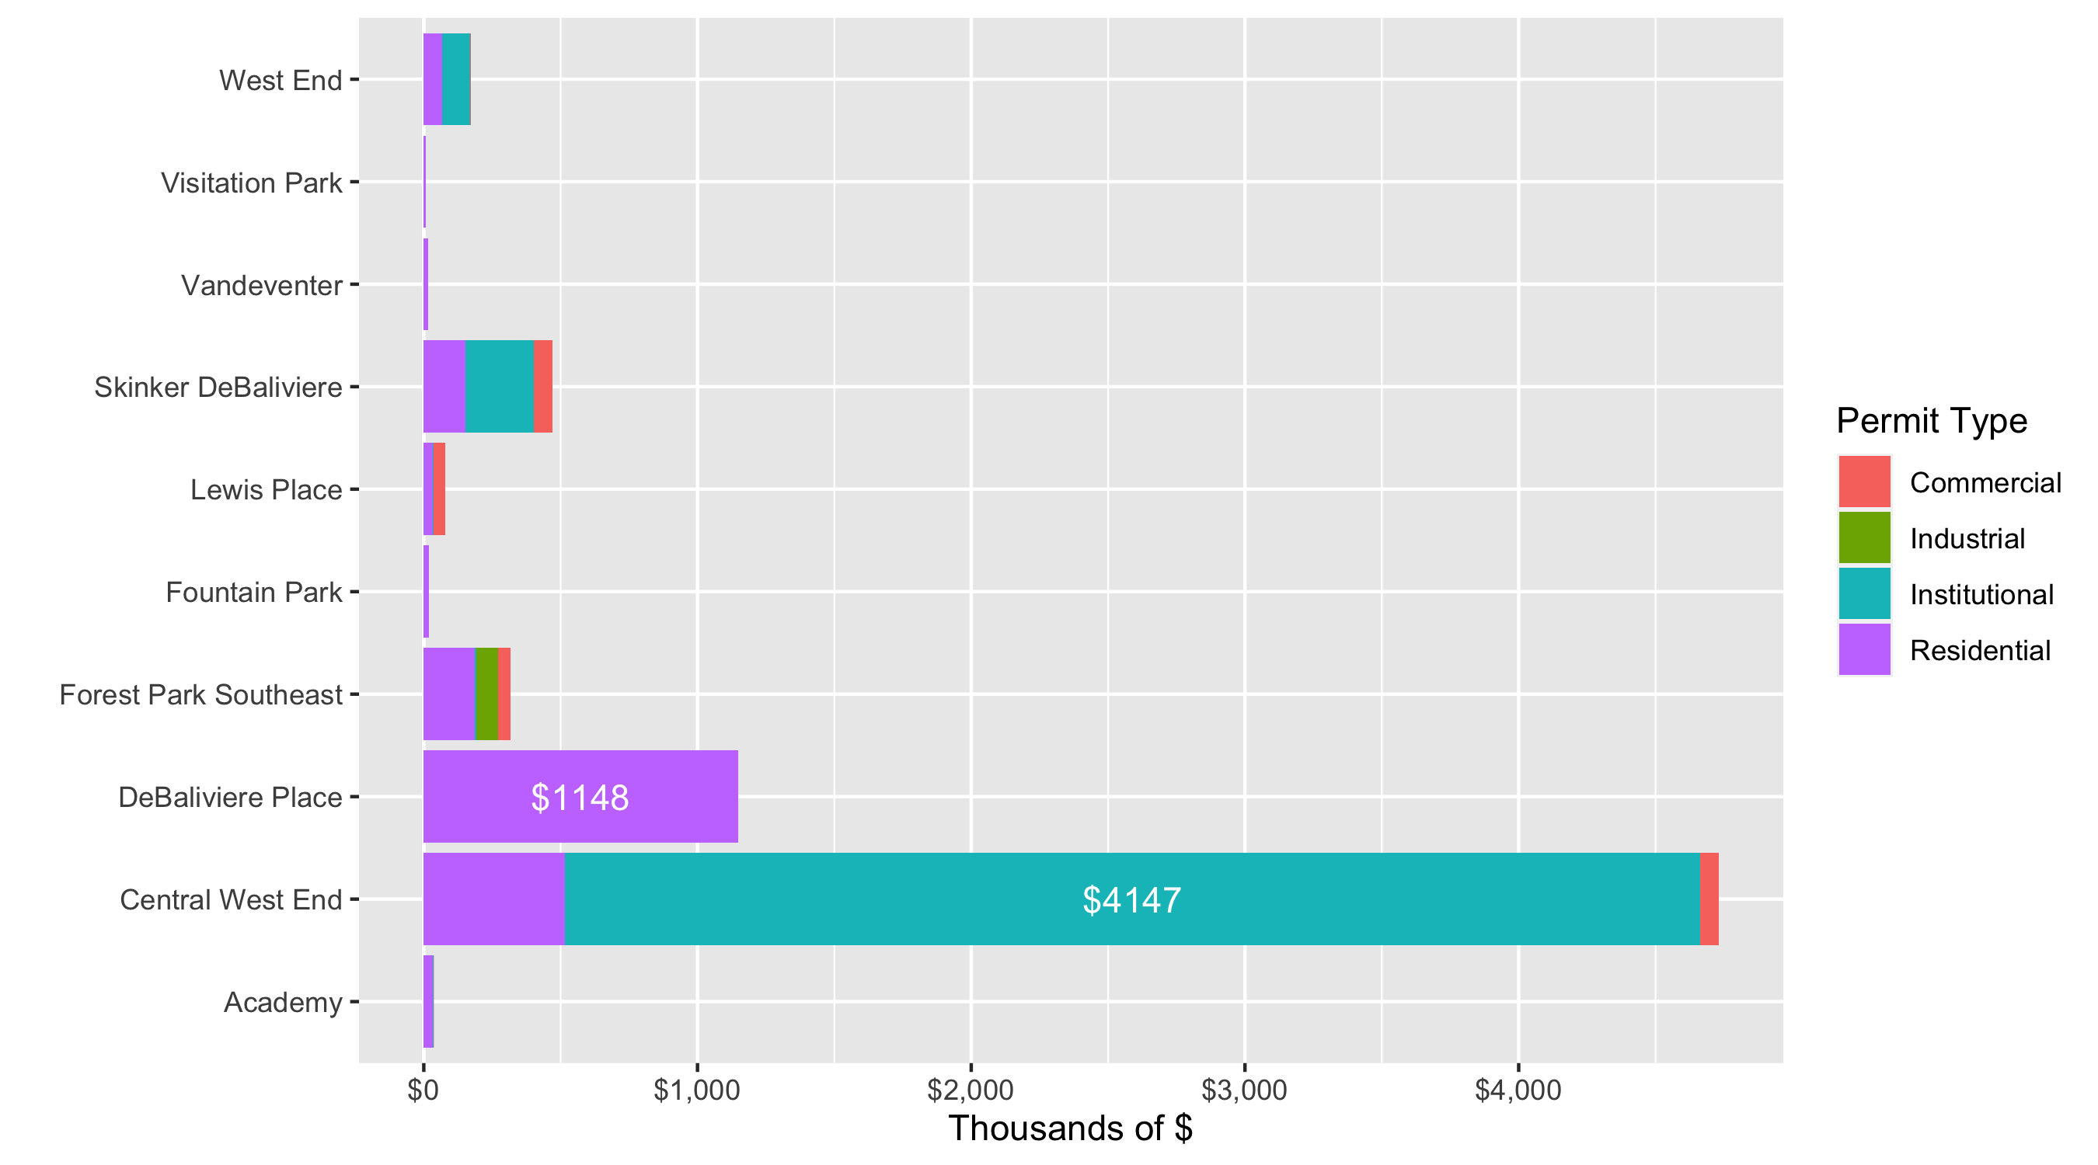
Neighborhood Summary: Total Building Permit Cost

Slide 4
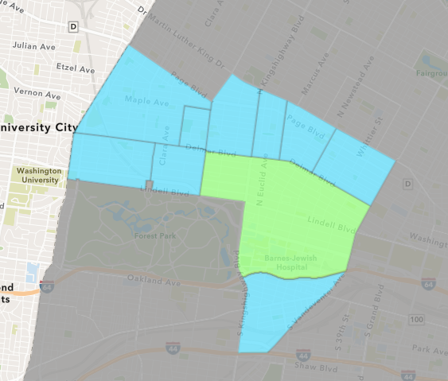
Central West End
Quarter 3 , 2020 Neighborhood Cost Breakdown
Sum of Permits: $45,009,000
Mean: $375,075
Median: $15,665
Range: $500 - $28,000,000

Slide 5
Central West End: Summary Notes
120 building permits in Quarter 3, 2020
-9.77% change compared to Quarter 3, 2019 (133 total building permits)
$375,075: Average building permit cost in Quarter 3, 2020
105.53% change compared to Quarter 3, 2019 ($182,493)

Slide 6
Central West End: Summary Notes
61 residential permits in Quarter 3, 2020
10.91% change compared to Quarter 3, 2019 (55 total building permits)
$84,732: Average residential building permit cost in Quarter 3, 2020
123.59% change compared to Quarter 3, 2019 ($37,895)
0 industrial permits in Quarter 3, 2020
-100.00% change compared to Quarter 3, 2019 (2 total building permits)
$0: Average industrial building permit cost in Quarter 3, 2020
-100.00% change compared to Quarter 3, 2019 ($5,000)

Slide 7
Central West End: Summary Notes
20 commercial permits in Quarter 3, 2020
-13.04% change compared to Quarter 3, 2019 (23 total building permits)
$33,718: Average commercial building permit cost in Quarter 3, 2020
-74.63% change compared to Quarter 3, 2019 ($132,924)
42 residential permits in Quarter 3, 2020
-20.75% change compared to Quarter 3, 2019 (53 total building permits)
$987,391: Average institutional building permit cost in Quarter 3, 2020
173.70% change compared to Quarter 3, 2019 ($5,000)

Slide 8
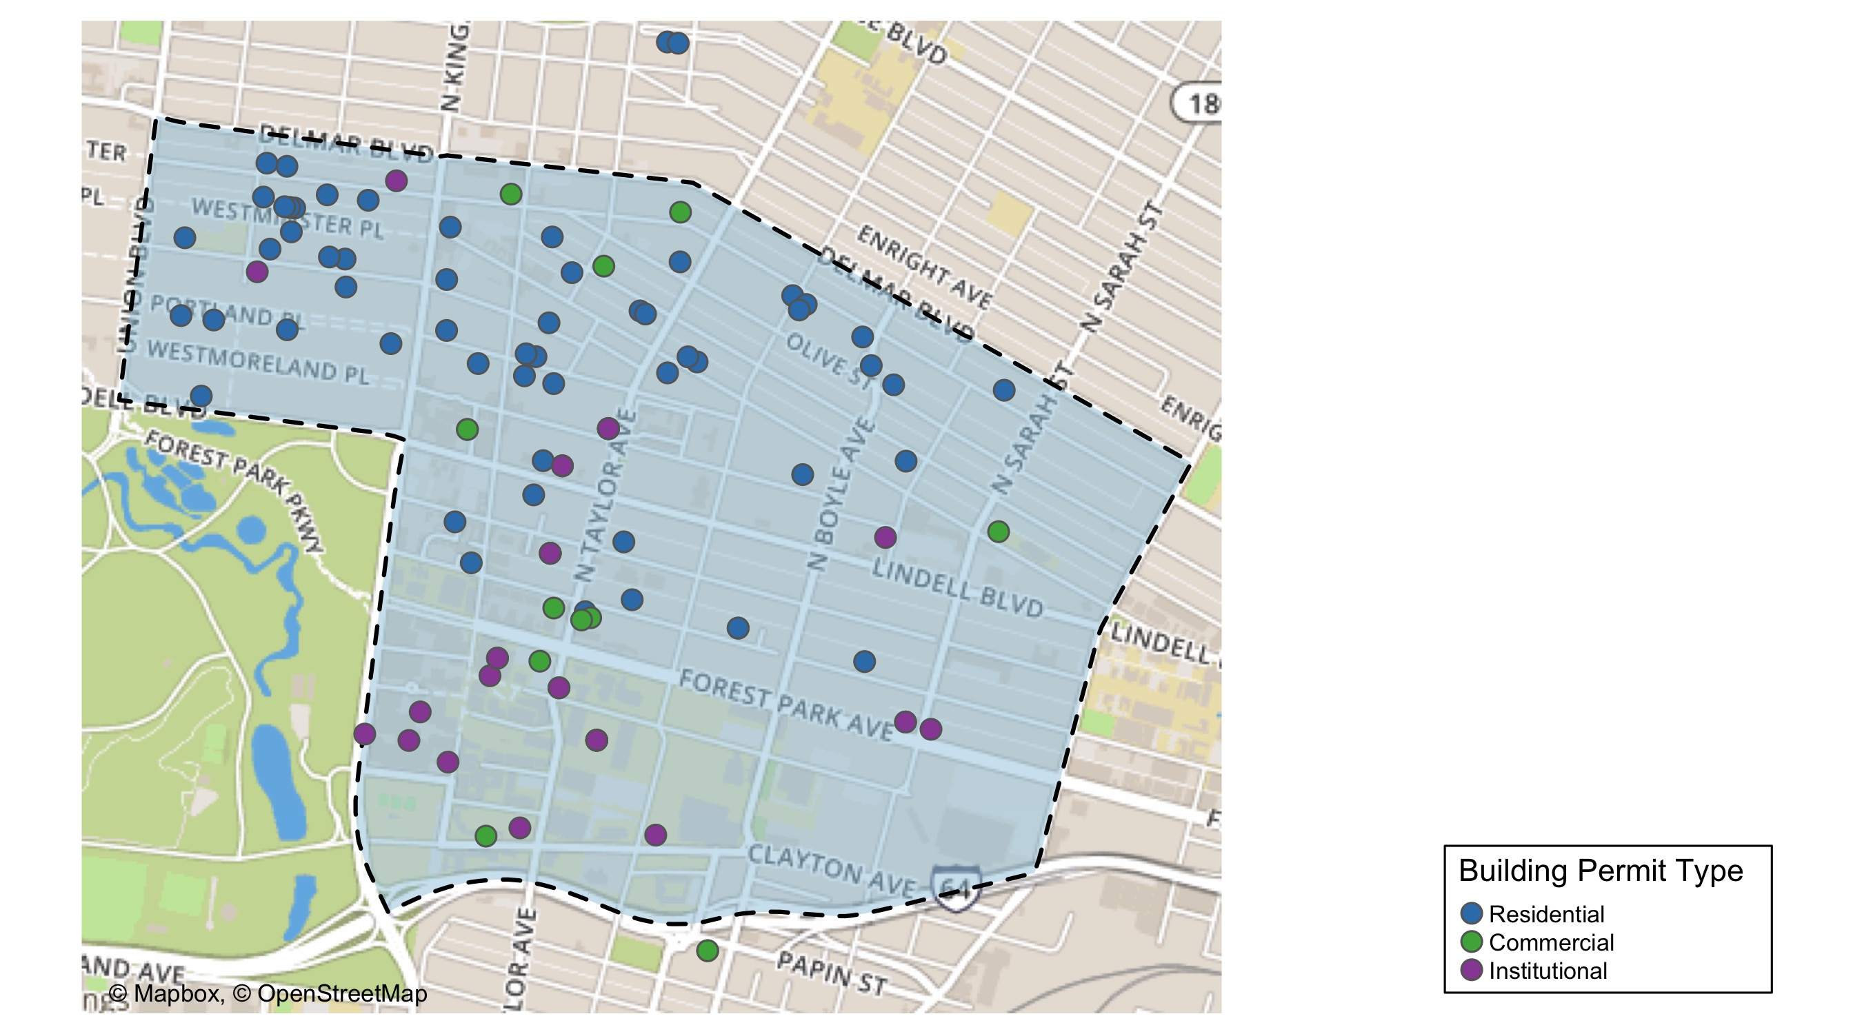
Central West End

Slide 9
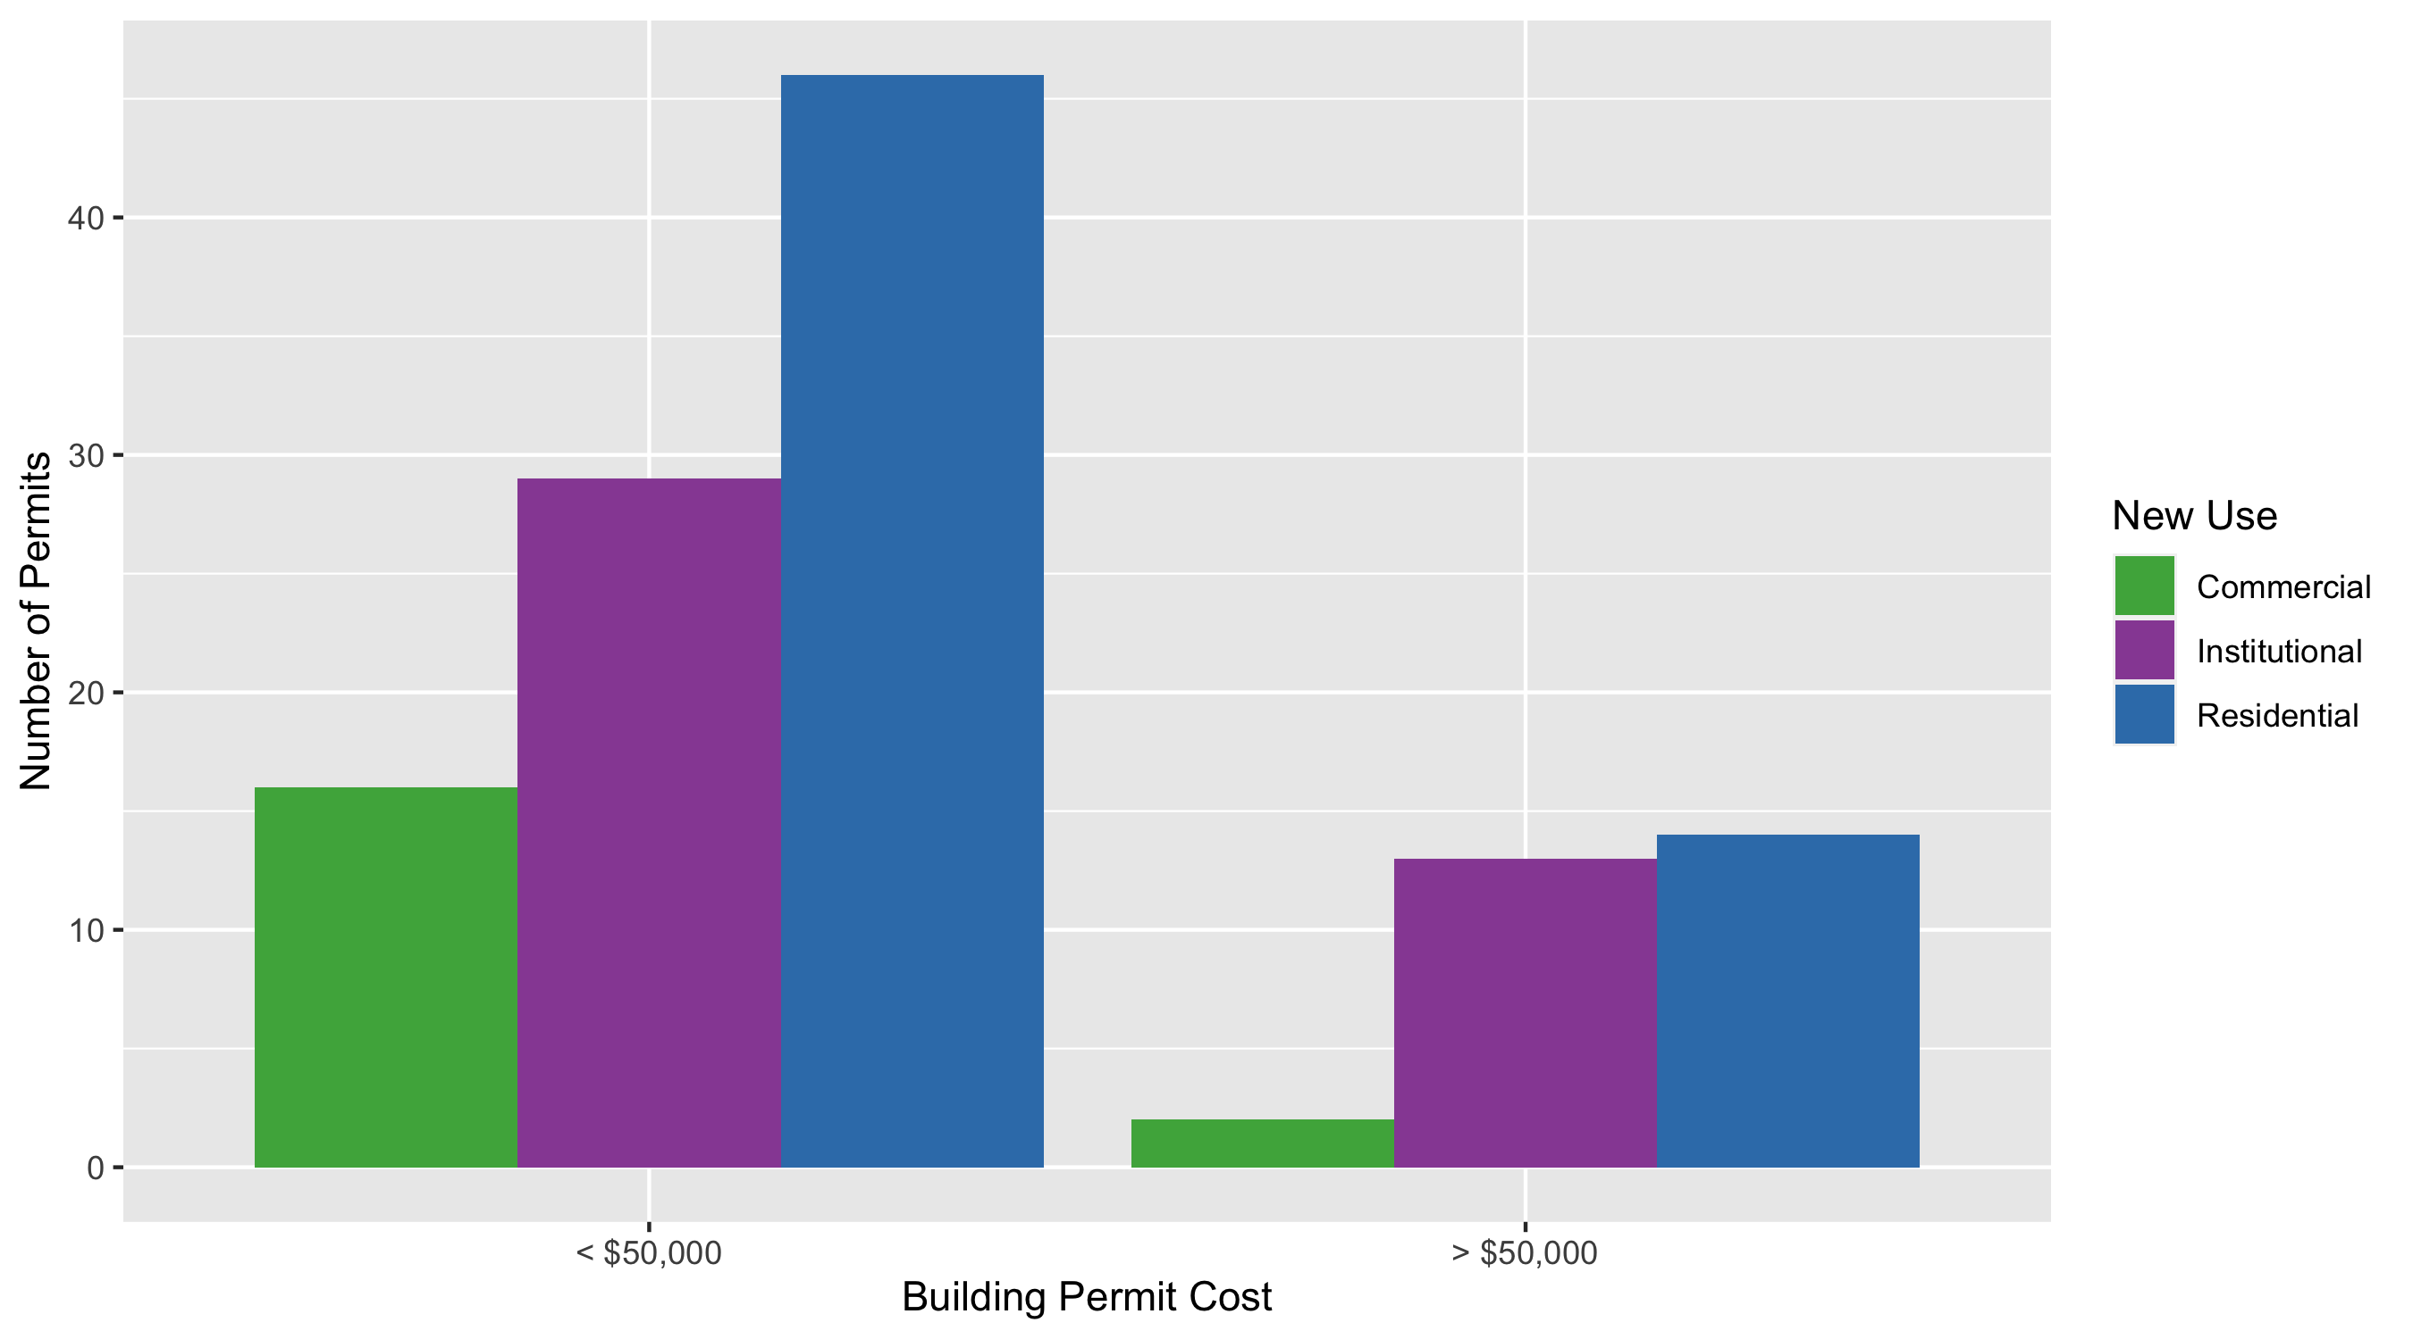
Central West End Permit Use Breakdown

Slide 10
Central West End Permit Breakdown
Quarter 3, 2020 | Quarter 3, 2020 | Quarter 3, 2020 | Quarter 3, 2020
Permit Use | Average Cost | # of Permits | Total Value of Permits
Commercial | $20,551 | 18 | $369,926
Industrial | $0 | 0 | $0
Institutional | $987,391 | 42 | $41,470,422
Residential | $52,811 | 60 | $3,168,652
Total | $1,060,753 | 120 | $45,009,000
Quarter 3, 2019 | Quarter 3, 2019 | Quarter 3, 2019 | Quarter 3, 2019
Permit Use | Average Cost | # of Permits | Total Value of Permits
Commercial | $132,924 | 23 | $3,057,250
Industrial | $5,000 | 2 | $10,000
Institutional | $360,756 | 53 | $19,120,082
Residential | $37,895 | 55 | $2,084,245
Total | $536,576 | 133 | $24,271,577

Slide 11
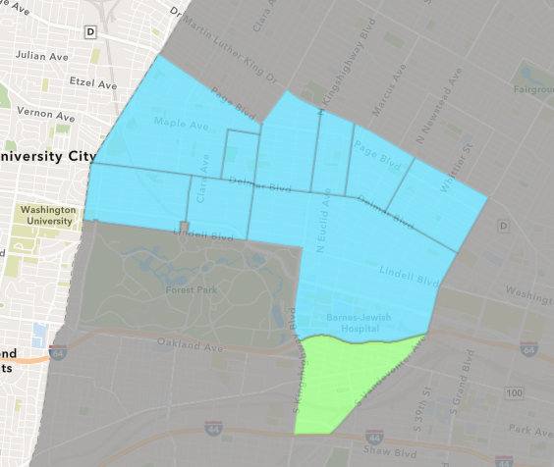
Forest Park Southeast
Quarter 3 , 2020 Neighborhood Cost Breakdown
Sum of Permits: $2,613,591
Mean: $62,228
Median: $10,000
Range: $300 - $600,000

Slide 12
Forest Park Southeast: Summary Notes
42 building permits in Quarter 3, 2020
-10.64% change compared to Quarter 3, 2019 (47 total building permits)
$62,228: Average building permit cost in Quarter 3, 2020
-83.35% change compared to Quarter 3, 2019 ($373,717)

Slide 13
Forest Park Southeast: Summary Notes
30 residential permits in Quarter 3, 2020
0.00% change compared to Quarter 3, 2019 (30 total building permits)
$62,453: Average residential building permit cost in Quarter 3, 2020
-80.57% change compared to Quarter 3, 2019 ($321,357)
3 industrial permits in Quarter 3, 2020
Infinite change compared to Quarter 3, 2019 (0 total building permits)
$267,033: Average industrial building permit cost in Quarter 3, 2020
Infinite change compared to Quarter 3, 2019 ($0)

Slide 14
Forest Park Southeast: Summary Notes
7 commercial permits in Quarter 3, 2020
-41.67% change compared to Quarter 3, 2019 (12 total building permits)
$63,586: Average commercial building permit cost in Quarter 3, 2020
-27.55% change compared to Quarter 3, 2019 ($87,766)
3 residential permits in Quarter 3, 2020
-40.00% change compared to Quarter 3, 2019 (5 total building permits)
$12,330: Average institutional building permit cost in Quarter 3, 2020
-99.10% change compared to Quarter 3, 2019 ($0)

Slide 15
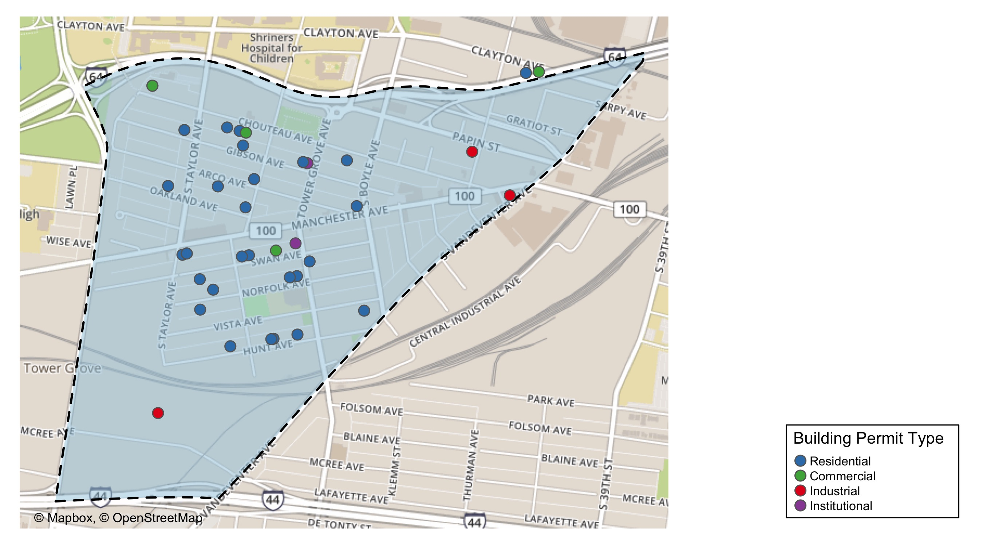
Forest Park Southeast

Slide 16
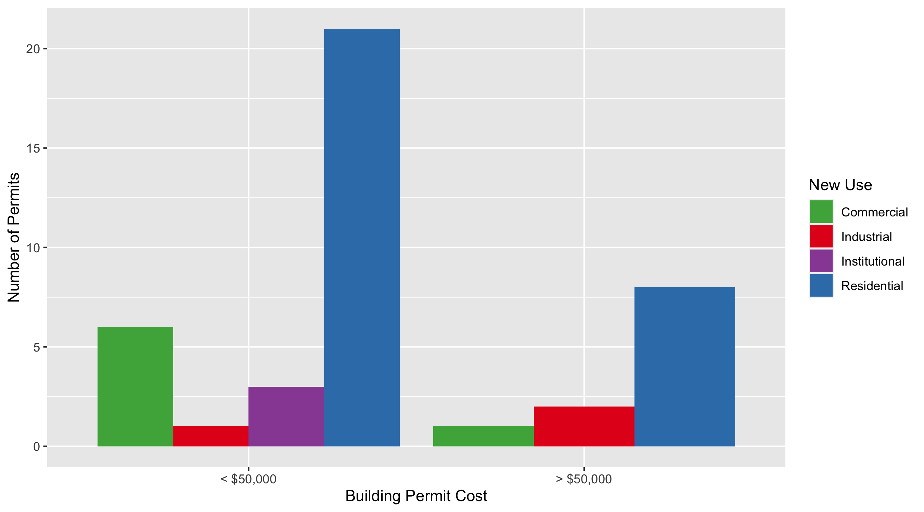
Forest Park Southeast Permit Use Breakdown

Slide 17
Forest Park Southeast Permit Breakdown
Quarter 3, 2020 | Quarter 3, 2020 | Quarter 3, 2020 | Quarter 3, 2020
Permit Use | Average Cost | # of Permits | Total Value of Permits
Commercial | $63,586 | 7 | $445,100
Industrial | $267,033 | 3 | $801,100
Institutional | $12,330 | 3 | $36,989
Residential | $45,876 | 29 | $1,330,402
Total | $388,825 | 42 | $2,613,591
Quarter 3, 2019 | Quarter 3, 2019 | Quarter 3, 2019 | Quarter 3, 2019
Permit Use | Average Cost | # of Permits | Total Value of Permits
Commercial | $87,766 | 12 | $1,053,195
Industrial | $0 | 0 | $0
Institutional | $1,374,161 | 5 | $6,870,807
Residential | $321,357 | 30 | $9,640,710
Total | $1,783,285 | 47 | $17,564,712

Slide 18
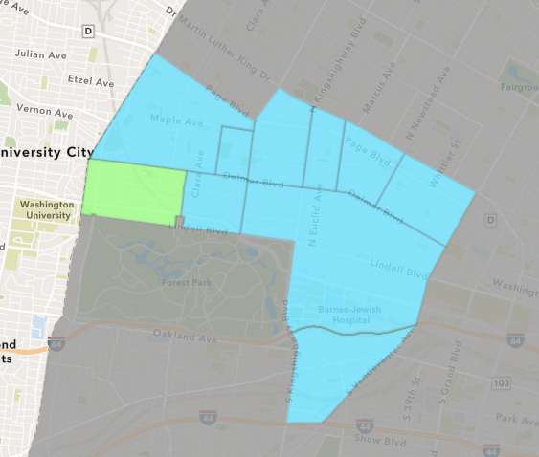
Skinker DeBaliviere
Quarter 3 , 2020 Neighborhood Cost Breakdown
Sum of Permits: $4,703,454
Mean: $134,384
Median: $12,900
Range: $937 - $2,006,500

Slide 19
Skinker DeBaliviere: Summary Notes
35 building permits in Quarter 3, 2020
75.00% change compared to Quarter 3, 2019 (20 total building permits)
$134,384: Average building permit cost in Quarter 3, 2020
319.93% change compared to Quarter 3, 2019 ($32,001)

Slide 20
Skinker DeBaliviere: Summary Notes
24 residential permits in Quarter 3, 2020
41.18% change compared to Quarter 3, 2019 (17 total building permits)
$63,098: Average residential building permit cost in Quarter 3, 2020
134.24% change compared to Quarter 3, 2019 ($26,937)
0 industrial permits in Quarter 3, 2020
0.00% change compared to Quarter 3, 2019 (0 total building permits)
$0: Average industrial building permit cost in Quarter 3, 2020
0.00% change compared to Quarter 3, 2019 ($0)

Slide 21
Skinker DeBaliviere: Summary Notes
7 commercial permits in Quarter 3, 2020
600.00% change compared to Quarter 3, 2019 (1 total building permits)
$97,584: Average commercial building permit cost in Quarter 3, 2020
290.34% change compared to Quarter 3, 2019 ($25,000)
4 residential permits in Quarter 3, 2020
100.00% change compared to Quarter 3, 2019 (2 total building permits)
$626,500: Average institutional building permit cost in Quarter 3, 2020
697.58% change compared to Quarter 3, 2019 ($0)

Slide 22
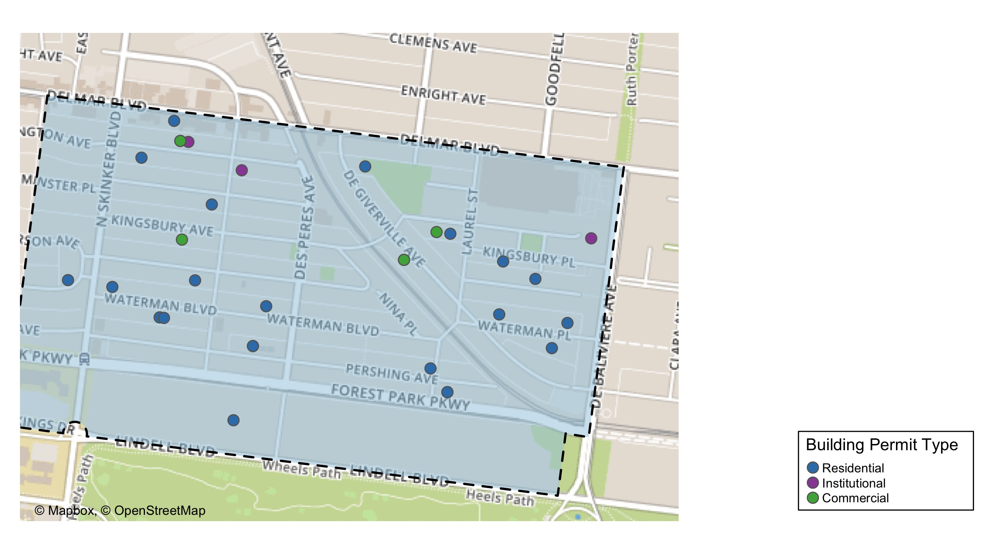
Skinker DeBaliviere

Slide 23
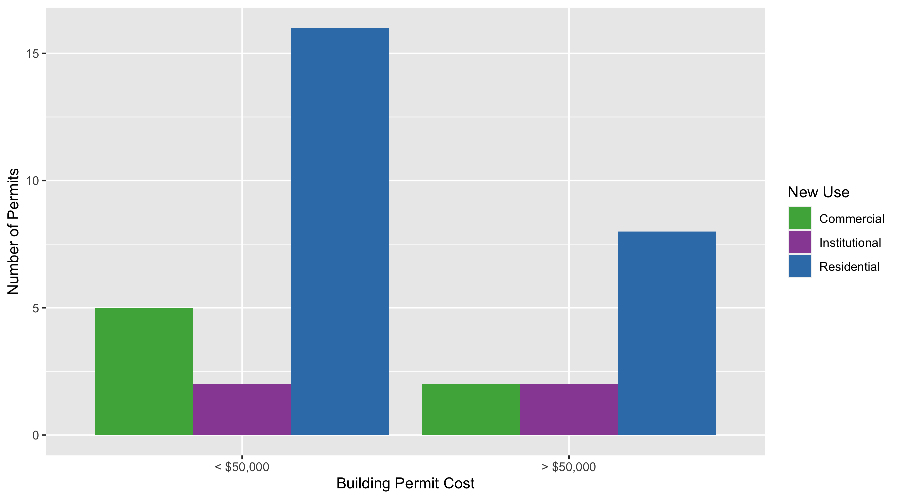
Skinker DeBaliviere Permit Use Breakdown

Slide 24
Skinker DeBaliviere Permit Breakdown
Quarter 3, 2020 | Quarter 3, 2020 | Quarter 3, 2020 | Quarter 3, 2020
Permit Use | Average Cost | # of Permits | Total Value of Permits
Commercial | $97,584 | 7 | $683,090
Industrial | $0 | 0 | $0
Institutional | $626,500 | 4 | $2,506,000
Residential | $63,098 | 24 | $1,514,364
Total | $787,183 | 35 | $4,703,454
Quarter 3, 2019 | Quarter 3, 2019 | Quarter 3, 2019 | Quarter 3, 2019
Permit Use | Average Cost | # of Permits | Total Value of Permits
Commercial | $25,000 | 1 | $25,000
Industrial | $0 | 0 | $0
Institutional | $78,550 | 2 | $157,100
Residential | $26,937 | 17 | $457,929
Total | $130,487 | 20 | $640,029

Slide 25
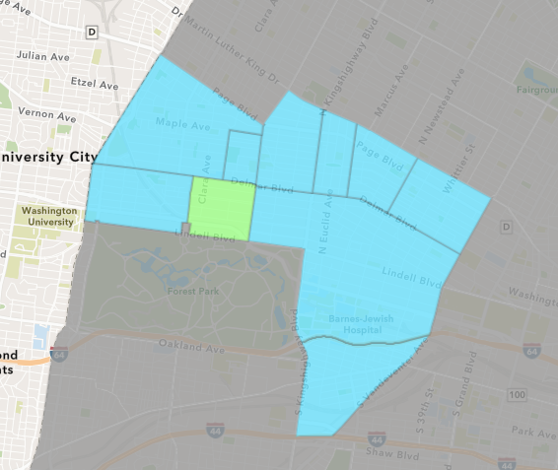
DeBaliviere Place
Quarter 3 , 2020 Neighborhood Cost Breakdown
Sum of Permits: $11,479,891
Mean: $499,126
Median: $60,000
Range: $100 - $7,150,000

Slide 26
DeBaliviere Place: Summary Notes
23 building permits in Quarter 3, 2020
64.29% change compared to Quarter 3, 2019 (14 total building permits)
$499,126: Average building permit cost in Quarter 3, 2020
717.84% change compared to Quarter 3, 2019 ($61,030)

Slide 27
DeBaliviere Place: Summary Notes
21 residential permits in Quarter 3, 2020
75.00% change compared to Quarter 3, 2019 (12 total building permits)
$546,605: Average residential building permit cost in Quarter 3, 2020
772.92% change compared to Quarter 3, 2019 ($62,618)
0 industrial permits in Quarter 3, 2020
0.00% change compared to Quarter 3, 2019 (0 total building permits)
$0: Average industrial building permit cost in Quarter 3, 2020
0.00% change compared to Quarter 3, 2019 ($0)

Slide 28
DeBaliviere Place: Summary Notes
1 commercial permits in Quarter 3, 2020
Infinite change compared to Quarter 3, 2019 (0 total building permits)
$780: Average commercial building permit cost in Quarter 3, 2020
Infinite change compared to Quarter 3, 2019 ($0)
1 residential permits in Quarter 3, 2020
-50.00% change compared to Quarter 3, 2019 (2 total building permits)
$400: Average institutional building permit cost in Quarter 3, 2020
-99.22% change compared to Quarter 3, 2019 ($0)

Slide 29
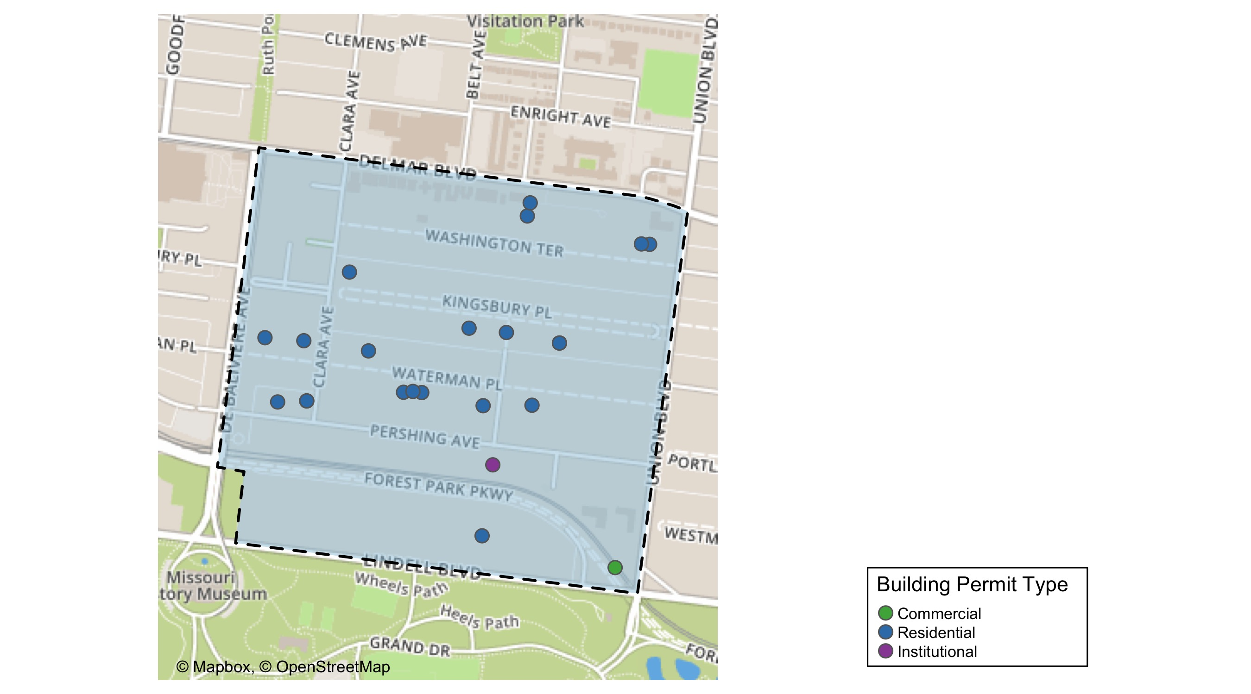
DeBaliviere Place

Slide 30
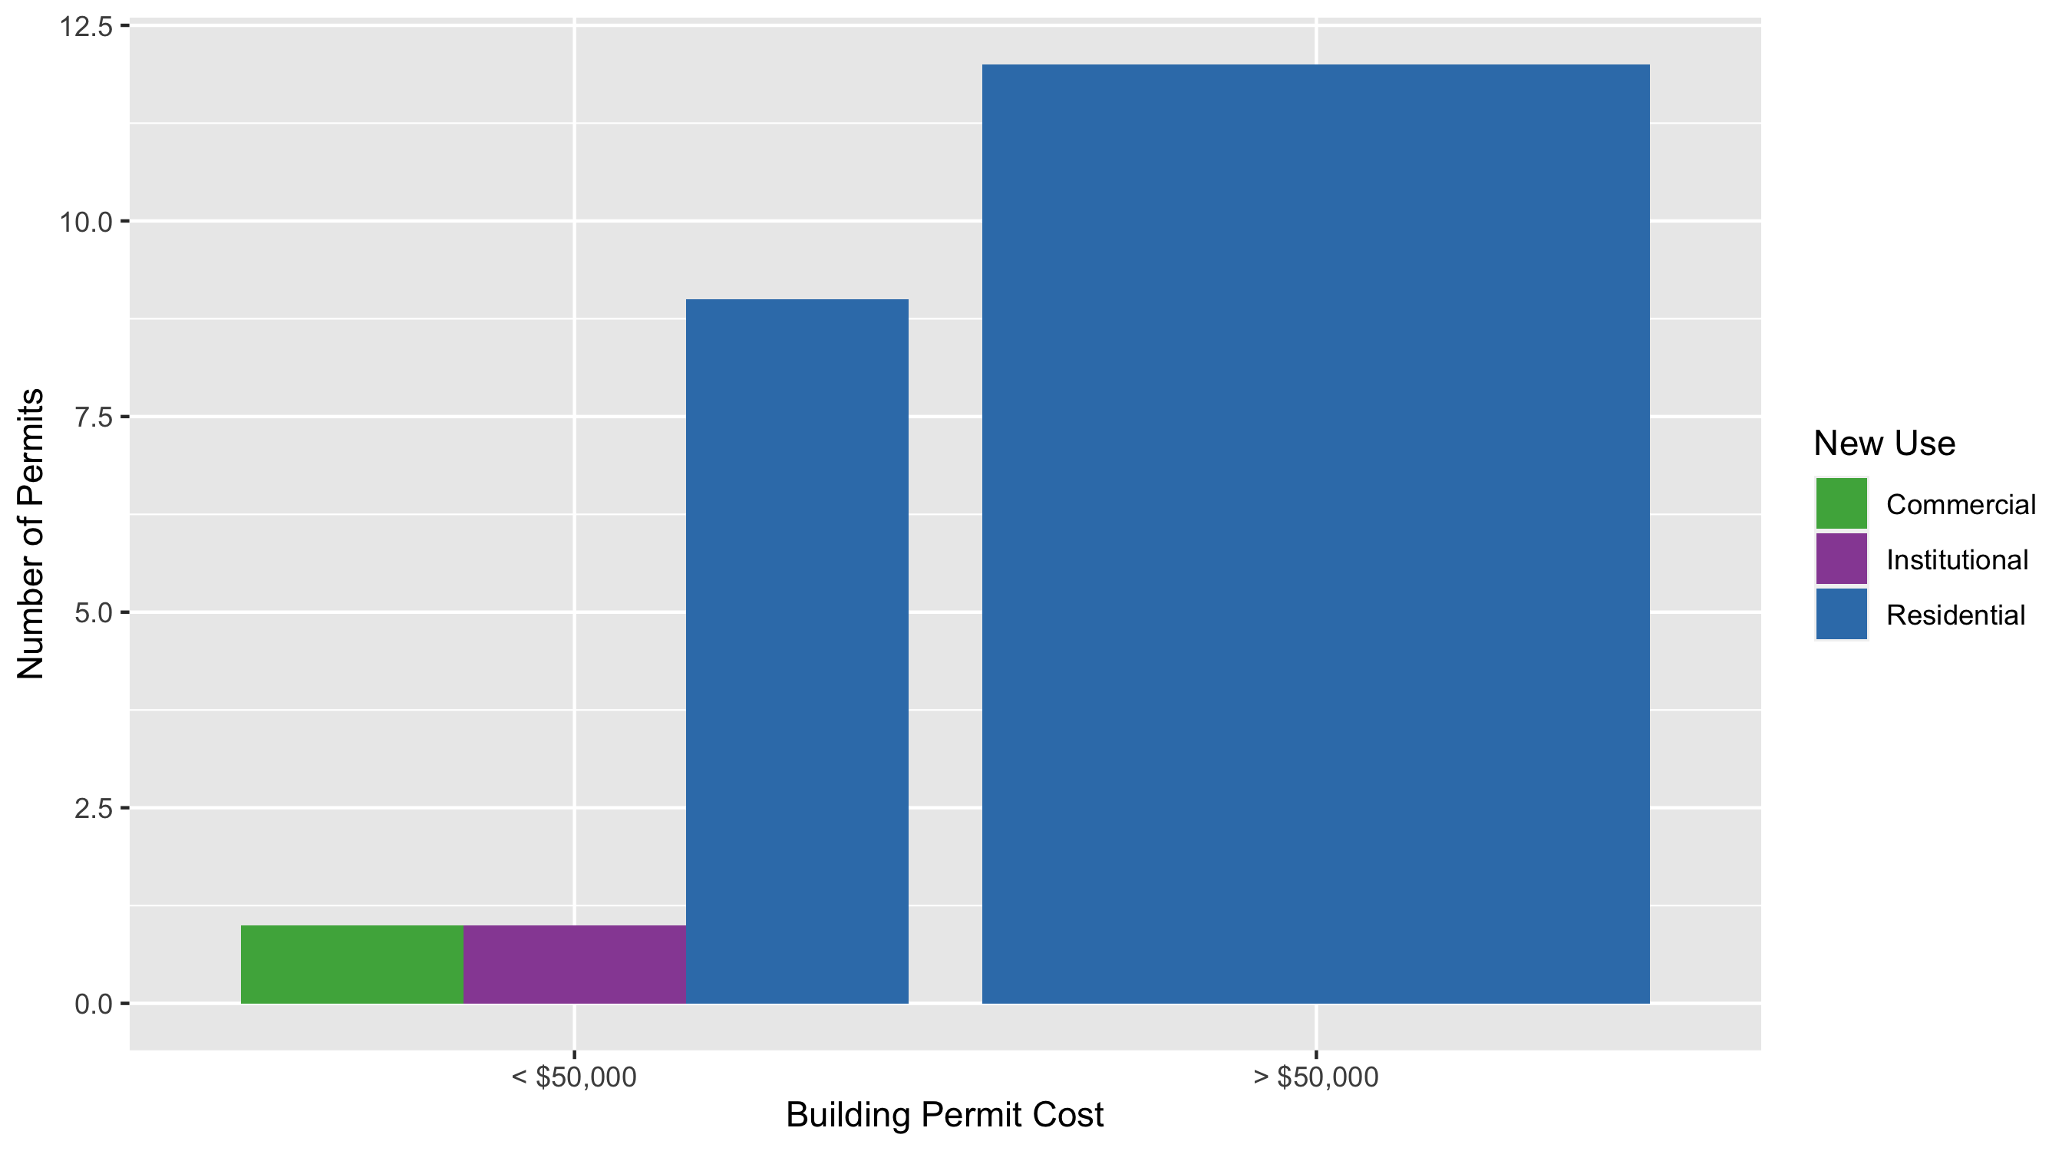
DeBaliviere Place Permit Use Breakdown

Slide 31
DeBaliviere Place Permit Breakdown
Quarter 3, 2020 | Quarter 3, 2020 | Quarter 3, 2020 | Quarter 3, 2020
Permit Use | Average Cost | # of Permits | Total Value of Permits
Commercial | $780 | 1 | $780
Industrial | $0 | 0 | $0
Institutional | $400 | 1 | $400
Residential | $546,605 | 21 | $11,478,711
Total | $547,785 | 23 | $11,479,891
Quarter 3, 2019 | Quarter 3, 2019 | Quarter 3, 2019 | Quarter 3, 2019
Permit Use | Average Cost | # of Permits | Total Value of Permits
Commercial | $0 | 0 | $0
Industrial | $0 | 0 | $0
Institutional | $51,500 | 2 | $103,000
Residential | $62,618 | 12 | $751,417
Total | $114,118 | 14 | $854,417

Slide 32
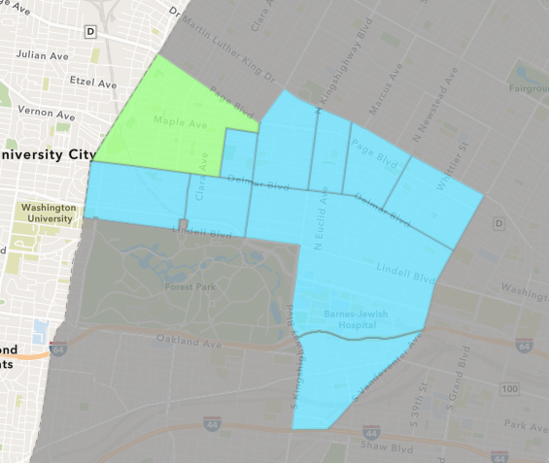
West End
Quarter 3 , 2020 Neighborhood Cost Breakdown
Sum of Permits: $1,711,533
Mean: $71,314
Median: $8,000
Range: $600 - $1,000,000

Slide 33
West End: Summary Notes
24 building permits in Quarter 3, 2020
14.29% change compared to Quarter 3, 2019 (21 total building permits)
$71,314: Average building permit cost in Quarter 3, 2020
-46.35% change compared to Quarter 3, 2019 ($132,936)

Slide 34
West End: Summary Notes
19 residential permits in Quarter 3, 2020
26.67% change compared to Quarter 3, 2019 (15 total building permits)
$34,693: Average residential building permit cost in Quarter 3, 2020
-36.83% change compared to Quarter 3, 2019 ($54,924)
0 industrial permits in Quarter 3, 2020
-100.00% change compared to Quarter 3, 2019 (1 total building permits)
$0: Average industrial building permit cost in Quarter 3, 2020
-100.00% change compared to Quarter 3, 2019 ($30,000)

Slide 35
West End: Summary Notes
3 commercial permits in Quarter 3, 2020
50.00% change compared to Quarter 3, 2019 (2 total building permits)
$3,444: Average commercial building permit cost in Quarter 3, 2020
-67.20% change compared to Quarter 3, 2019 ($10,500)
2 residential permits in Quarter 3, 2020
-33.33% change compared to Quarter 3, 2019 (3 total building permits)
$521,018: Average institutional building permit cost in Quarter 3, 2020
-18.46% change compared to Quarter 3, 2019 ($30,000)

Slide 36
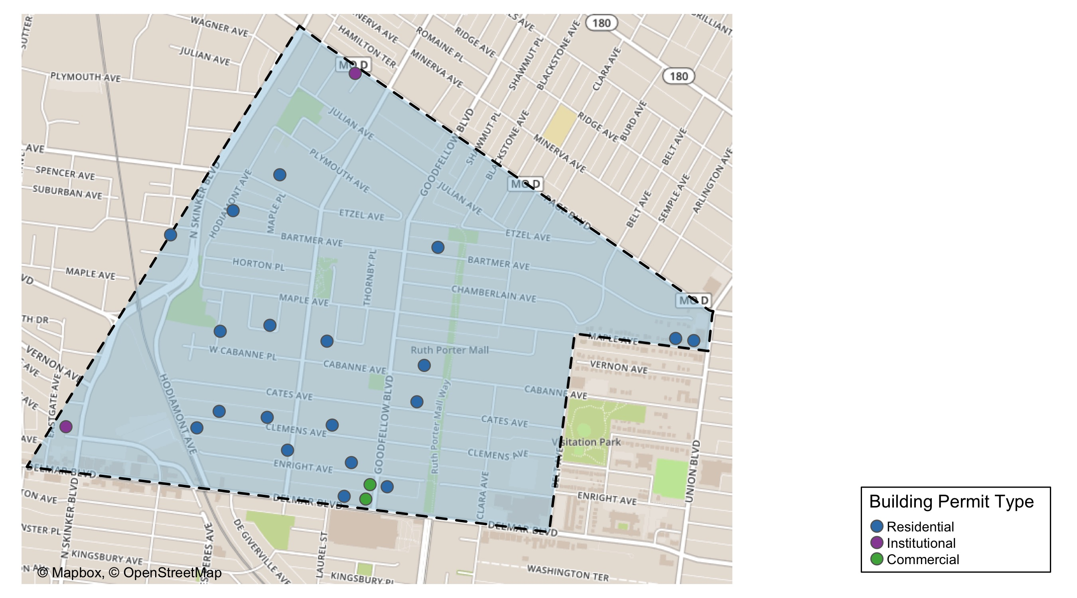
West End

Slide 37
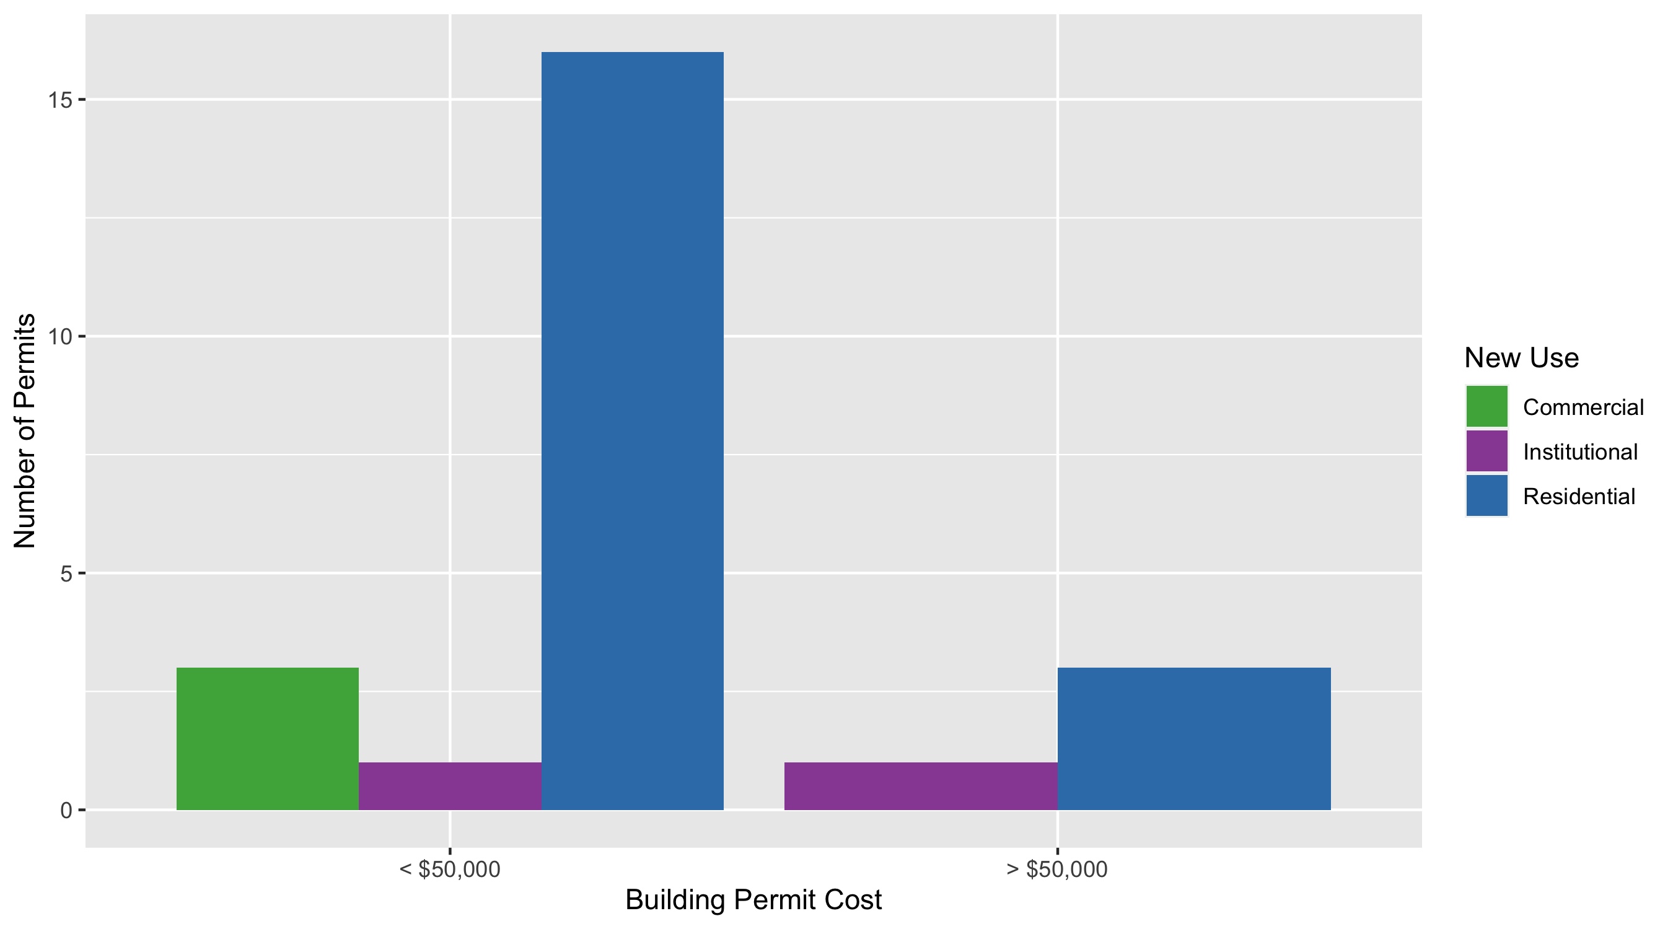
West End Permit Use Breakdown

Slide 38
West End Permit Breakdown
Quarter 3, 2020 | Quarter 3, 2020 | Quarter 3, 2020 | Quarter 3, 2020
Permit Use | Average Cost | # of Permits | Total Value of Permits
Commercial | $3,444 | 3 | $10,332
Industrial | $0 | 0 | $0
Institutional | $521,018 | 2 | $1,042,035
Residential | $34,693 | 19 | $659,166
Total | $559,154 | 24 | $1,711,533
Quarter 3, 2019 | Quarter 3, 2019 | Quarter 3, 2019 | Quarter 3, 2019
Permit Use | Average Cost | # of Permits | Total Value of Permits
Commercial | $10,500 | 2 | $21,000
Industrial | $30,000 | 1 | $30,000
Institutional | $638,935 | 3 | $1,916,806
Residential | $54,924 | 15 | $823,856
Total | $734,359 | 21 | $2,791,662

Slide 39
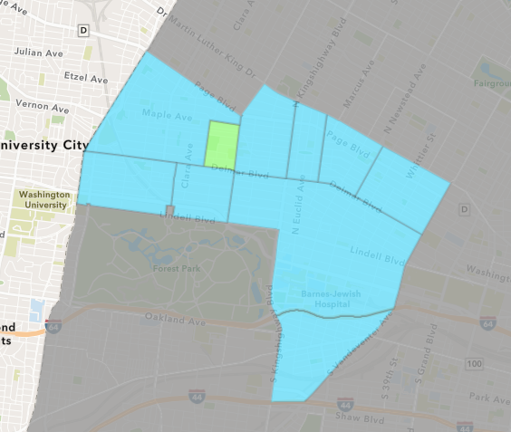
Visitation Park
Quarter 3 , 2020 Neighborhood Cost Breakdown
Sum of Permits: $88,205
Mean: $22,051
Median: $8,200
Range: $6,261 - $65,544

Slide 40
Visitation Park: Summary Notes
4 building permits in Quarter 3, 2020
300.00% change compared to Quarter 3, 2019 (1 total building permits)
$22,051: Average building permit cost in Quarter 3, 2020
175.64% change compared to Quarter 3, 2019 ($8,000)

Slide 41
Visitation Park: Summary Notes
4 residential permits in Quarter 3, 2020
300.00% change compared to Quarter 3, 2019 (1 total building permits)
$22,051: Average residential building permit cost in Quarter 3, 2020
175.64% change compared to Quarter 3, 2019 ($8,000)
0 industrial permits in Quarter 3, 2020
0.00% change compared to Quarter 3, 2019 (0 total building permits)
$0: Average industrial building permit cost in Quarter 3, 2020
0.00% change compared to Quarter 3, 2019 ($0)

Slide 42
Visitation Park: Summary Notes
0 commercial permits in Quarter 3, 2020
0.00% change compared to Quarter 3, 2019 (0 total building permits)
$0: Average commercial building permit cost in Quarter 3, 2020
0.00% change compared to Quarter 3, 2019 ($0)
0 residential permits in Quarter 3, 2020
0.00% change compared to Quarter 3, 2019 (0 total building permits)
$0: Average institutional building permit cost in Quarter 3, 2020
0.00% change compared to Quarter 3, 2019 ($0)

Slide 43
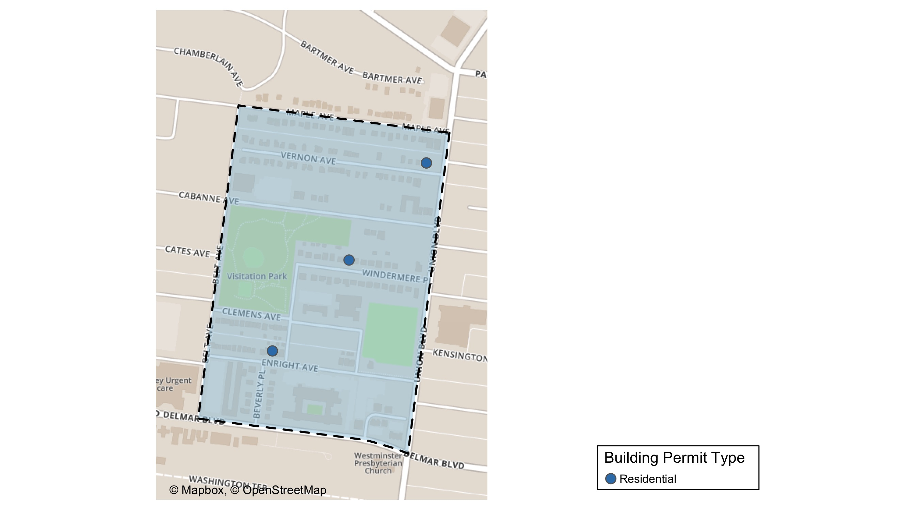
Visitation Park

Slide 44
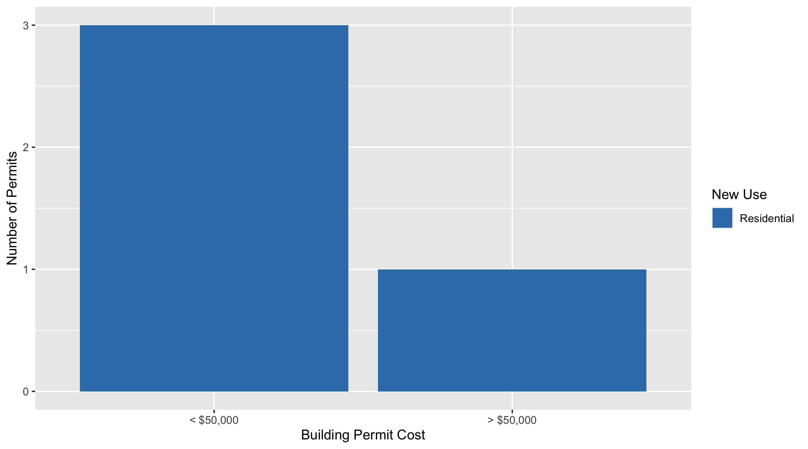
Visitation Park Permit Use Breakdown

Slide 45
Visitation Park Permit Breakdown
Quarter 3, 2020 | Quarter 3, 2020 | Quarter 3, 2020 | Quarter 3, 2020
Permit Use | Average Cost | # of Permits | Total Value of Permits
Commercial | $0 | 0 | $0
Industrial | $0 | 0 | $0
Institutional | $0 | 0 | $0
Residential | $22,051 | 4 | $88,205
Total | $22,051 | 4 | $88,205
Quarter 3, 2019 | Quarter 3, 2019 | Quarter 3, 2019 | Quarter 3, 2019
Permit Use | Average Cost | # of Permits | Total Value of Permits
Commercial | $0 | 0 | $0
Industrial | $0 | 0 | $0
Institutional | $0 | 0 | $0
Residential | $8,000 | 1 | $8,000
Total | $8,000 | 1 | $8,000

Slide 46
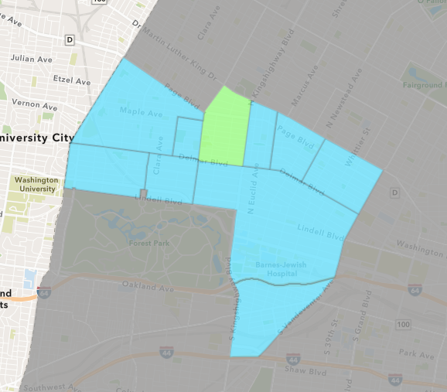
Academy
Quarter 3 , 2020 Neighborhood Cost Breakdown
Sum of Permits: $358,620
Mean: $25,616
Median: $6,000
Range: $200 - $150,000

Slide 47
Academy: Summary Notes
14 building permits in Quarter 3, 2020
16.67% change compared to Quarter 3, 2019 (12 total building permits)
$25,616: Average building permit cost in Quarter 3, 2020
-41.99% change compared to Quarter 3, 2019 ($44,154)

Slide 48
Academy: Summary Notes
12 residential permits in Quarter 3, 2020
71.43% change compared to Quarter 3, 2019 (7 total building permits)
$28,635: Average residential building permit cost in Quarter 3, 2020
-9.30% change compared to Quarter 3, 2019 ($31,571)
0 industrial permits in Quarter 3, 2020
0.00% change compared to Quarter 3, 2019 (0 total building permits)
$0: Average industrial building permit cost in Quarter 3, 2020
0.00% change compared to Quarter 3, 2019 ($0)

Slide 49
Academy: Summary Notes
1 commercial permits in Quarter 3, 2020
-66.67% change compared to Quarter 3, 2019 (3 total building permits)
$10,000: Average commercial building permit cost in Quarter 3, 2020
238.98% change compared to Quarter 3, 2019 ($2,950)
1 residential permits in Quarter 3, 2020
-50.00% change compared to Quarter 3, 2019 (2 total building permits)
$5,000: Average institutional building permit cost in Quarter 3, 2020
-96.67% change compared to Quarter 3, 2019 ($0)

Slide 50
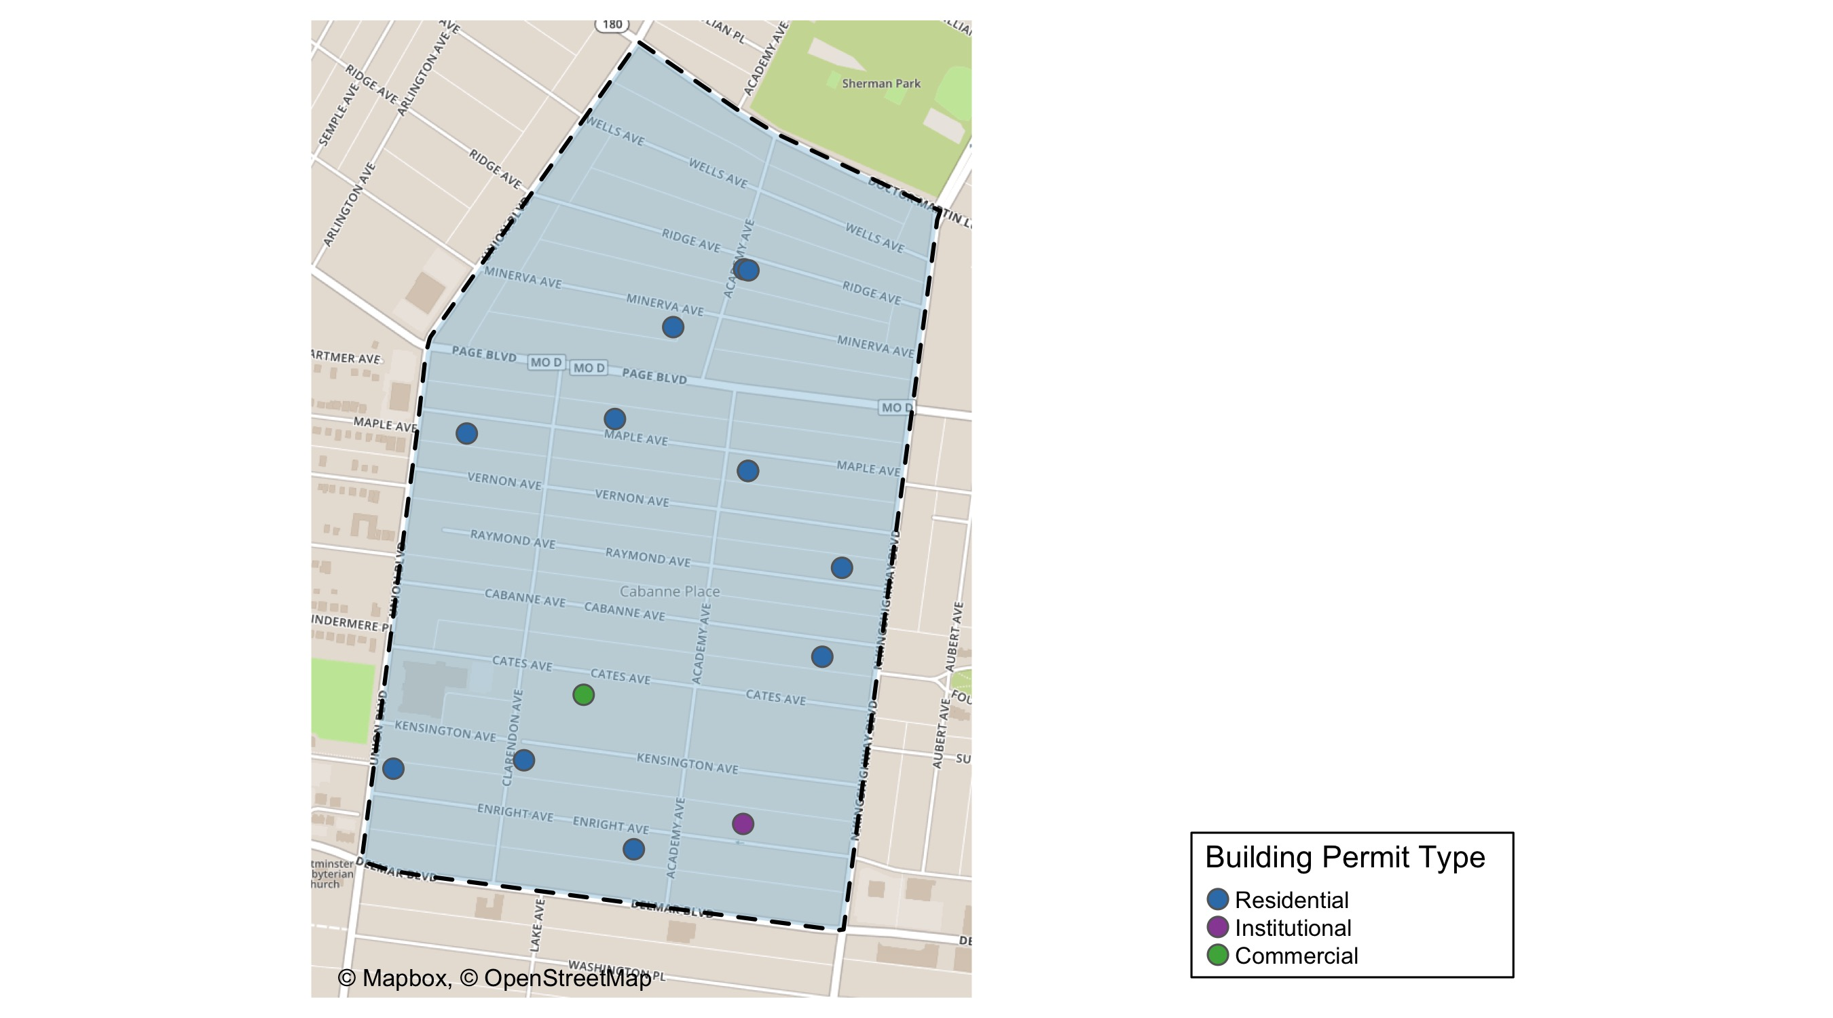
Academy

Slide 51
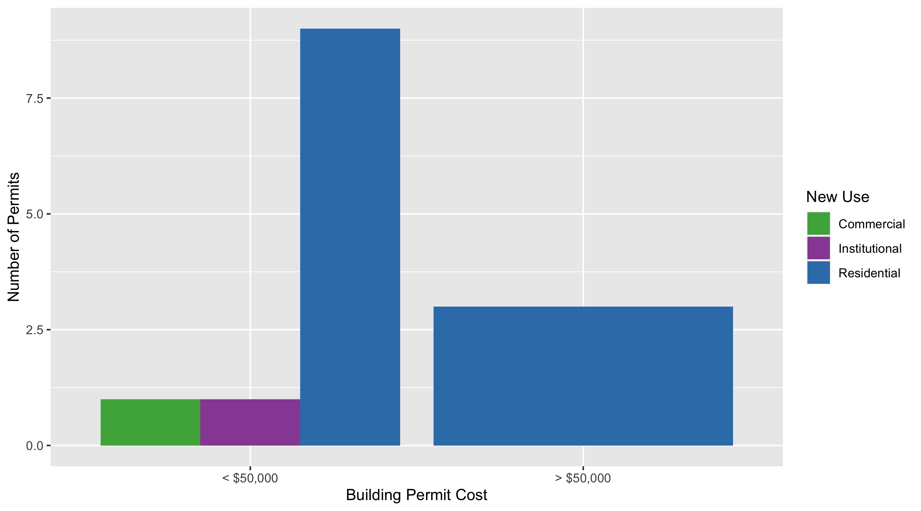
Academy Permit Use Breakdown

Slide 52
Academy Permit Breakdown
Quarter 3, 2020 | Quarter 3, 2020 | Quarter 3, 2020 | Quarter 3, 2020
Permit Use | Average Cost | # of Permits | Total Value of Permits
Commercial | $10,000 | 1 | $10,000
Industrial | $0 | 0 | $0
Institutional | $5,000 | 1 | $5,000
Residential | $28,635 | 12 | $343,620
Total | $43,635 | 14 | $358,620
Quarter 3, 2019 | Quarter 3, 2019 | Quarter 3, 2019 | Quarter 3, 2019
Permit Use | Average Cost | # of Permits | Total Value of Permits
Commercial | $2,950 | 3 | $8,850
Industrial | $0 | 0 | $0
Institutional | $150,000 | 2 | $300,000
Residential | $31,571 | 7 | $221,000
Total | $184,521 | 12 | $529,850

Slide 53
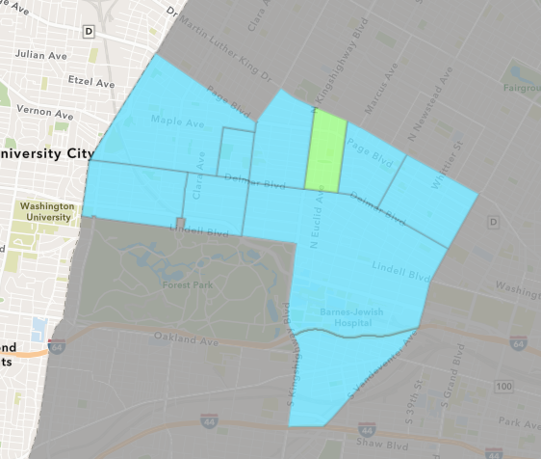
Fountain Park
Quarter 3 , 2020 Neighborhood Cost Breakdown
Sum of Permits: $175,000
Mean: $175,000
Median: $175,000
Range: $175,000 - $175,000

Slide 54
Fountain Park: Summary Notes
1 building permits in Quarter 3, 2020
-75.00% change compared to Quarter 3, 2019 (4 total building permits)
$175,000: Average building permit cost in Quarter 3, 2020
444.05% change compared to Quarter 3, 2019 ($32,166)

Slide 55
Fountain Park: Summary Notes
1 residential permits in Quarter 3, 2020
-50.00% change compared to Quarter 3, 2019 (2 total building permits)
$175,000: Average residential building permit cost in Quarter 3, 2020
241.46% change compared to Quarter 3, 2019 ($51,250)
0 industrial permits in Quarter 3, 2020
0.00% change compared to Quarter 3, 2019 (0 total building permits)
$0: Average industrial building permit cost in Quarter 3, 2020
0.00% change compared to Quarter 3, 2019 ($0)

Slide 56
Fountain Park: Summary Notes
0 commercial permits in Quarter 3, 2020
-100.00% change compared to Quarter 3, 2019 (2 total building permits)
$0: Average commercial building permit cost in Quarter 3, 2020
-100.00% change compared to Quarter 3, 2019 ($13,082)
0 residential permits in Quarter 3, 2020
0.00% change compared to Quarter 3, 2019 (0 total building permits)
$0: Average institutional building permit cost in Quarter 3, 2020
0.00% change compared to Quarter 3, 2019 ($0)

Slide 57
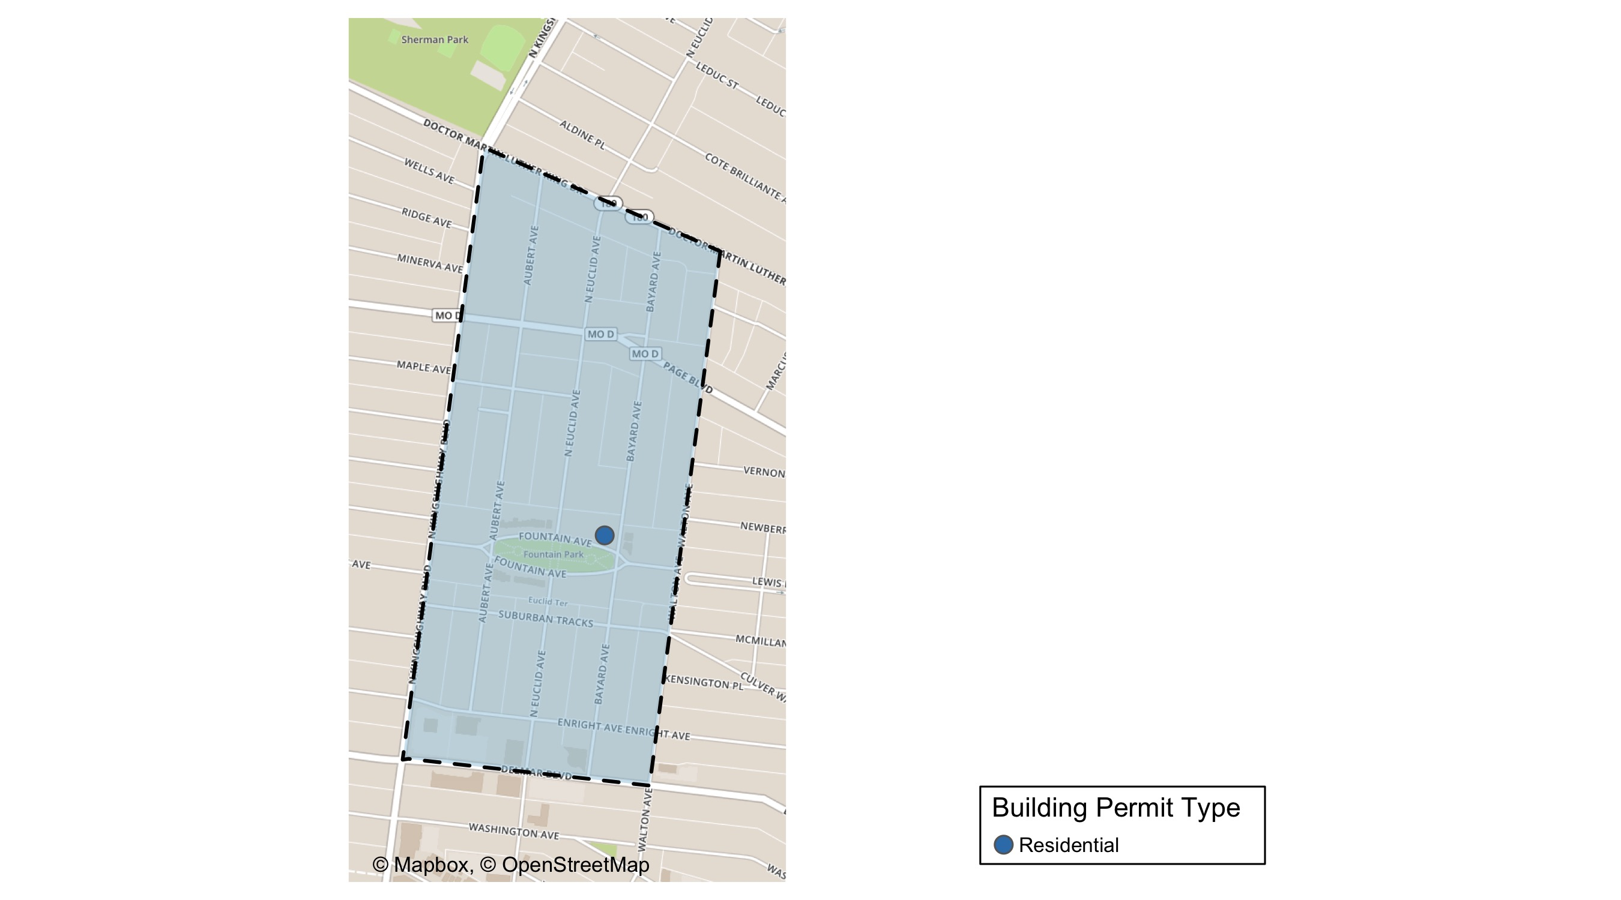
Fountain Park

Slide 58
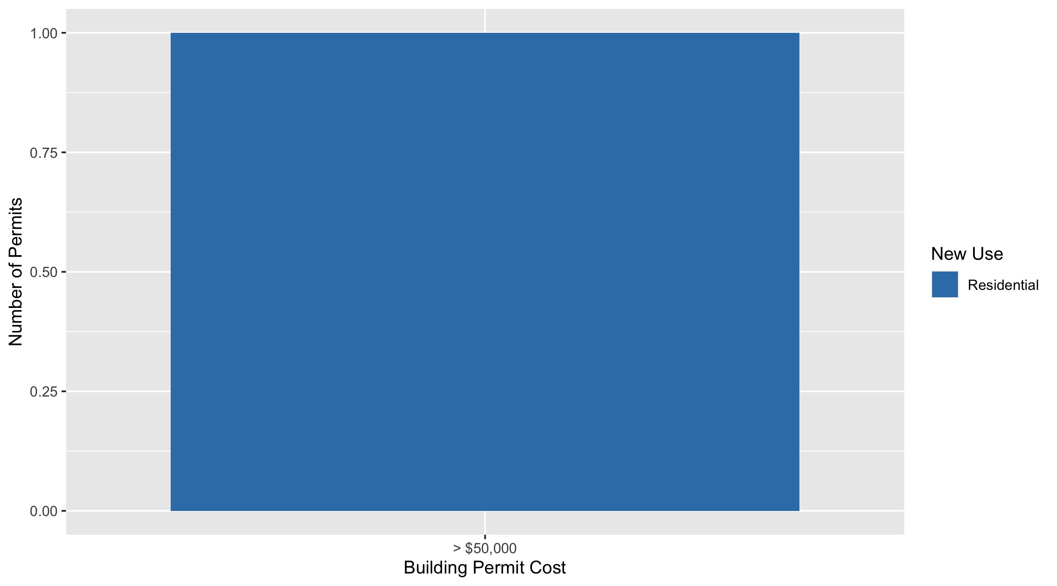
Fountain Park Permit Use Breakdown

Slide 59
Fountain Park Permit Breakdown
Quarter 3, 2020 | Quarter 3, 2020 | Quarter 3, 2020 | Quarter 3, 2020
Permit Use | Average Cost | # of Permits | Total Value of Permits
Commercial | $0 | 0 | $0
Industrial | $0 | 0 | $0
Institutional | $0 | 0 | $0
Residential | $175,000 | 1 | $175,000
Total | $175,000 | 1 | $175,000
Quarter 3, 2019 | Quarter 3, 2019 | Quarter 3, 2019 | Quarter 3, 2019
Permit Use | Average Cost | # of Permits | Total Value of Permits
Commercial | $13,082 | 2 | $26,165
Industrial | $0 | 0 | $0
Institutional | $0 | 0 | $0
Residential | $51,250 | 2 | $102,500
Total | $64,332 | 4 | $128,665

Slide 60
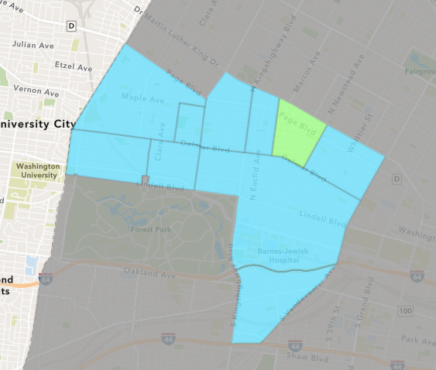
Lewis Place
Quarter 3 , 2020 Neighborhood Cost Breakdown
Sum of Permits: $788,260
Mean: $78,826
Median: $9,895
Range: $3,500 - $425,000

Slide 61
Lewis Place: Summary Notes
10 building permits in Quarter 3, 2020
900.00% change compared to Quarter 3, 2019 (1 total building permits)
$78,826: Average building permit cost in Quarter 3, 2020
425.51% change compared to Quarter 3, 2019 ($15,000)

Slide 62
Lewis Place: Summary Notes
7 residential permits in Quarter 3, 2020
Infinite change compared to Quarter 3, 2019 (0 total building permits)
$49,037: Average residential building permit cost in Quarter 3, 2020
Infinite change compared to Quarter 3, 2019 ($0)
0 industrial permits in Quarter 3, 2020
0.00% change compared to Quarter 3, 2019 (0 total building permits)
$0: Average industrial building permit cost in Quarter 3, 2020
0.00% change compared to Quarter 3, 2019 ($0)

Slide 63
Lewis Place: Summary Notes
2 commercial permits in Quarter 3, 2020
100.00% change compared to Quarter 3, 2019 (1 total building permits)
$217,500: Average commercial building permit cost in Quarter 3, 2020
1350.00% change compared to Quarter 3, 2019 ($15,000)
1 residential permits in Quarter 3, 2020
Infinite change compared to Quarter 3, 2019 (0 total building permits)
$10,000: Average institutional building permit cost in Quarter 3, 2020
Infinite change compared to Quarter 3, 2019 ($0)

Slide 64
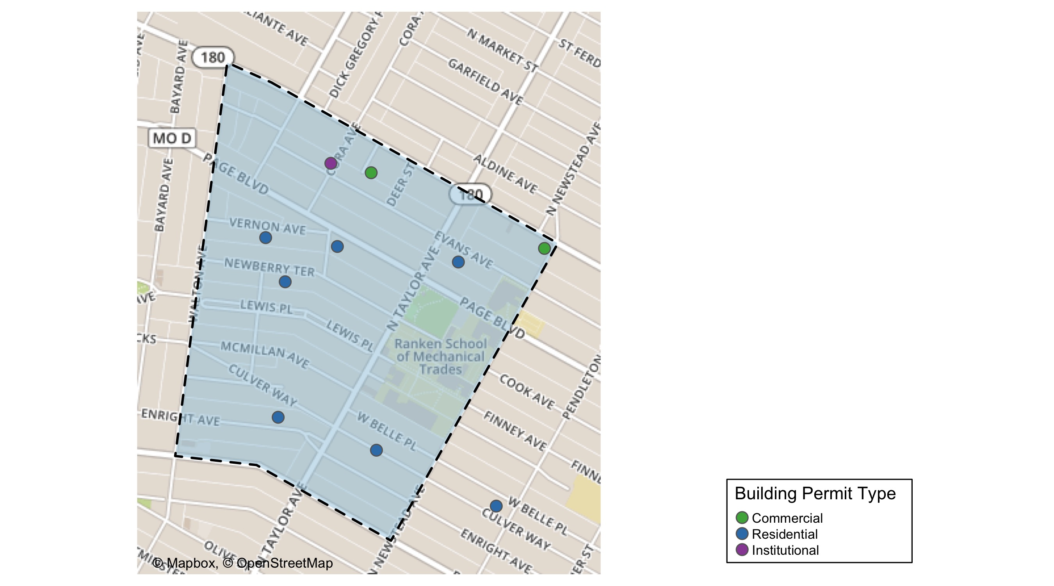
Lewis Place

Slide 65
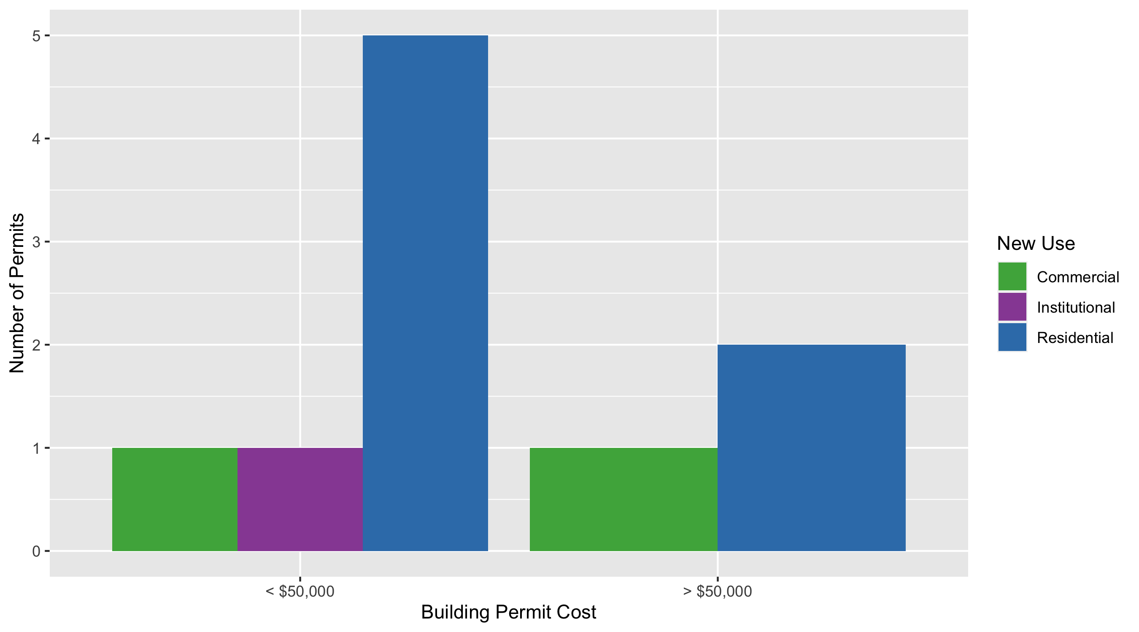
Lewis Place Permit Use Breakdown

Slide 66
Lewis Place Permit Breakdown
Quarter 3, 2020 | Quarter 3, 2020 | Quarter 3, 2020 | Quarter 3, 2020
Permit Use | Average Cost | # of Permits | Total Value of Permits
Commercial | $217,500 | 2 | $435,000
Industrial | $0 | 0 | $0
Institutional | $10,000 | 1 | $10,000
Residential | $49,037 | 7 | $343,260
Total | $276,537 | 10 | $788,260
Quarter 3, 2019 | Quarter 3, 2019 | Quarter 3, 2019 | Quarter 3, 2019
Permit Use | Average Cost | # of Permits | Total Value of Permits
Commercial | $15,000 | 1 | $15,000
Industrial | $0 | 0 | $0
Institutional | $0 | 0 | $0
Residential | $0 | 0 | $0
Total | $15,000 | 1 | $15,000

Slide 67
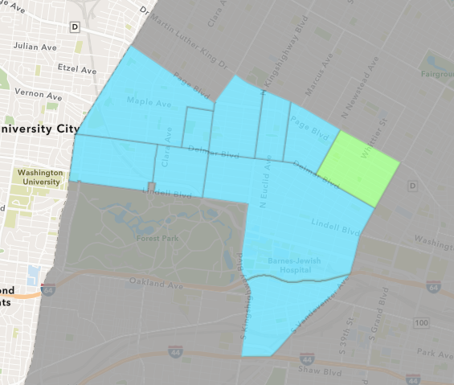
Vandeventer
Quarter 3 , 2020 Neighborhood Cost Breakdown
Sum of Permits: $163,649
Mean: $54,550
Median: $13,000
Range: $5,649 - $145,000

Slide 68
Vandeventer: Summary Notes
3 building permits in Quarter 3, 2020
-66.67% change compared to Quarter 3, 2019 (9 total building permits)
$54,550: Average building permit cost in Quarter 3, 2020
11.68% change compared to Quarter 3, 2019 ($48,844)

Slide 69
Vandeventer: Summary Notes
3 residential permits in Quarter 3, 2020
-57.14% change compared to Quarter 3, 2019 (7 total building permits)
$54,550: Average residential building permit cost in Quarter 3, 2020
13.11% change compared to Quarter 3, 2019 ($48,229)
0 industrial permits in Quarter 3, 2020
0.00% change compared to Quarter 3, 2019 (0 total building permits)
$0: Average industrial building permit cost in Quarter 3, 2020
0.00% change compared to Quarter 3, 2019 ($0)

Slide 70
Vandeventer: Summary Notes
0 commercial permits in Quarter 3, 2020
-100.00% change compared to Quarter 3, 2019 (1 total building permits)
$0: Average commercial building permit cost in Quarter 3, 2020
-100.00% change compared to Quarter 3, 2019 ($1,000)
0 residential permits in Quarter 3, 2020
-100.00% change compared to Quarter 3, 2019 (1 total building permits)
$0: Average institutional building permit cost in Quarter 3, 2020
-100.00% change compared to Quarter 3, 2019 ($0)

Slide 71
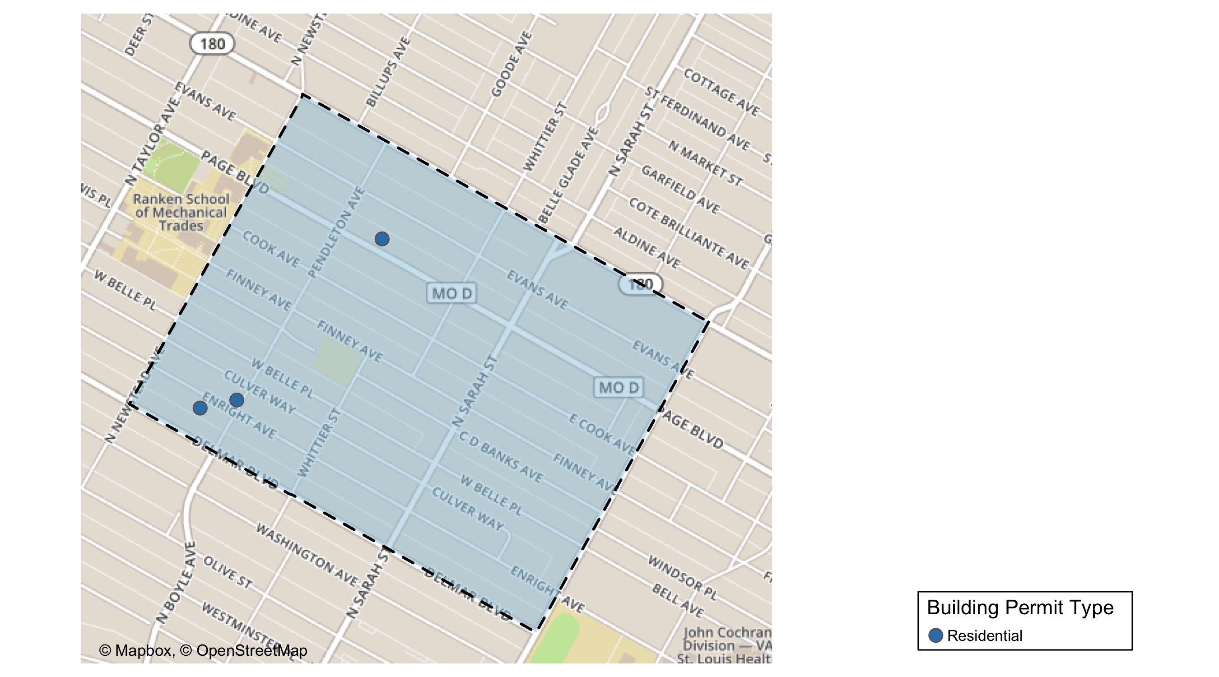
Vandeventer

Slide 72
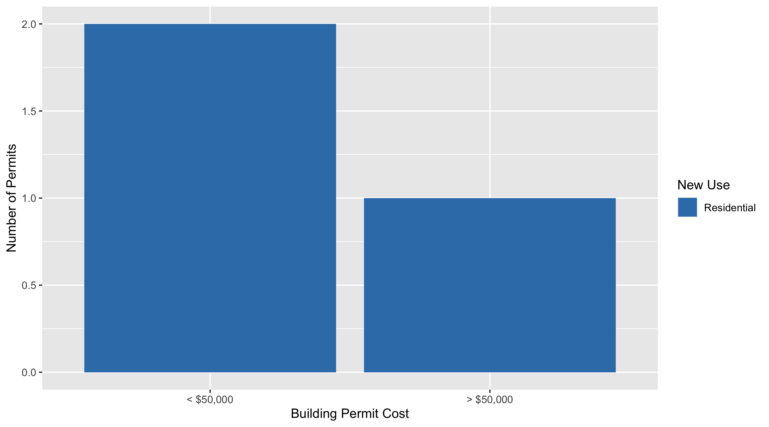
Vandeventer Permit Use Breakdown

Slide 73
Vandeventer Permit Breakdown
Quarter 3, 2020 | Quarter 3, 2020 | Quarter 3, 2020 | Quarter 3, 2020
Permit Use | Average Cost | # of Permits | Total Value of Permits
Commercial | $0 | 0 | $0
Industrial | $0 | 0 | $0
Institutional | $0 | 0 | $0
Residential | $54,550 | 3 | $163,649
Total | $54,550 | 3 | $163,649
Quarter 3, 2019 | Quarter 3, 2019 | Quarter 3, 2019 | Quarter 3, 2019
Permit Use | Average Cost | # of Permits | Total Value of Permits
Commercial | $1,000 | 1 | $1,000
Industrial | $0 | 0 | $0
Institutional | $101,000 | 1 | $101,000
Residential | $48,229 | 7 | $337,600
Total | $150,229 | 9 | $439,600

Slide 74
Additional Notes
Data retreived from https://www.stlouis-mo.gov/data/
Building permits with a cost of $0 were dropped
Building permits that were cancelled were dropped
Infinite change indicates 0 permits in the current or previous time period/comparison month so there was a overall increase or decrease

